Slide 1
The Maven Roasters
Case Study
A Research Project by Satarupa Talukdar
Top Ranked Data Science & Analytics Education Provider since 2007

Slide 2
Contents
Who Are The Maven Roasters? : About the Case Study
Objective of The Analysis
Knowing The Dataset
Data Analysis
  Sales Trend Analysis
  Store-Wise Sales Analysis
  Product Sales Analysis
  Business Growth Analysis
Findings
Top Ranked Data Science & Analytics Education Provider since 2007

Slide 3
Who Are The Maven Roasters? : About the Case Study
Maven Roasters is a fictitious coffee shop that runs in New York City. It has branches in three locations: Astoria ,Hell's Kitchen and Lower Manhattan. The shop sells nine categories of products: Bakery, Branded items, Coffee, Coffee Beans, Drinking Chocolate, Flavours, Loose Tea, Tea and Packaged Chocolate.
Top Ranked Data Science & Analytics Education Provider since 2007

Slide 4
Objective Of The Analysis
This analysis is carried forward to help Maven Roasters gain meaningful insights about their business by looking into:
The trends in the sales over time
Highest revenue generating products
Store-wise performances
Overall growth of the business
Requitement of any improvisions for the betterment of the business
The data analysis has been done by using MySQL.
Top Ranked Data Science & Analytics Education Provider since 2007

Slide 5
Knowing The Dataset
The dataset comprises of three tables namely, Transaction_data, Product_data and Store_data.
The data specifications are mentioned below:
Transaction_data
Product_data
Store_data
Field Name | Data Type
Transaction_id | Int
Transaction_qty | Int
Store_id | Int
Product_id | Int
Revenue | Double
Date_ | Date
Time_ | Time
Field Name | Data Type
Product_id | Int
Unit_price | Double
Product_category | Text
Product_type | Text
Product_detail | text
Field Name | Data Type
Store_id | Int
store_location | Text
Top Ranked Data Science & Analytics Education Provider since 2007

Slide 6
Knowing The Dataset
There are 1,49,116 rows in the transaction_data table, 87 rows in the product_data table and 3 rows in the store_data table.
There are a total of 87 products (product_detail) that are sub-categorized into 29 groups (product_type) which are further categorized into 9 groups (product_category).
The time period of the data is from January, 2023 to June, 2023.
Top Ranked Data Science & Analytics Education Provider since 2007

Slide 7
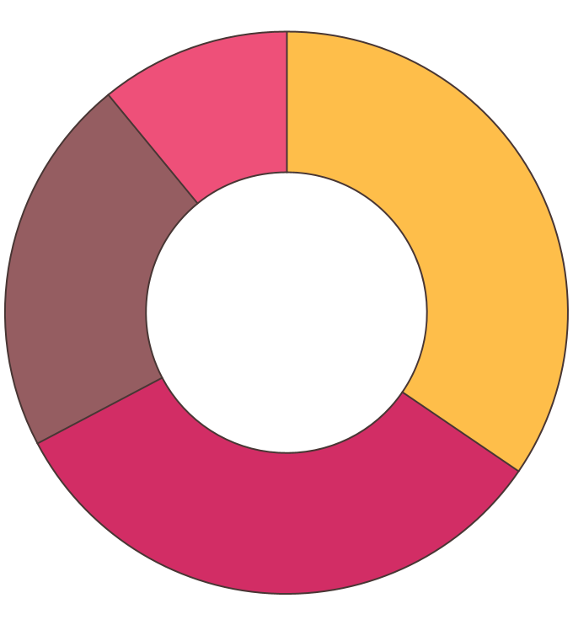
Data Analysis
Top Ranked Data Science & Analytics Education Provider since 2007

Slide 8
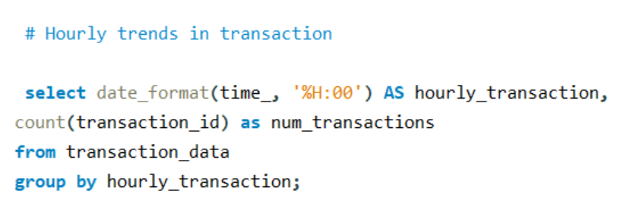
Sales Trend Analysis
Analyzing the hourly sales trend.
The results show that the peak hour of sales is 10:00 AM.
Top Ranked Data Science & Analytics Education Provider since 2007

Slide 9
Top Ranked Data Science & Analytics Education Provider since 2007

Slide 10
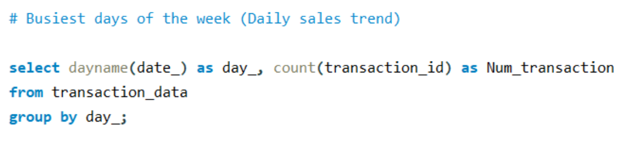
Sales Trend Analysis
Analyzing the daily sales trend.
The results show that the usually Fridays are the busiest days of the week.
Top Ranked Data Science & Analytics Education Provider since 2007

Slide 11
Top Ranked Data Science & Analytics Education Provider since 2007

Slide 12
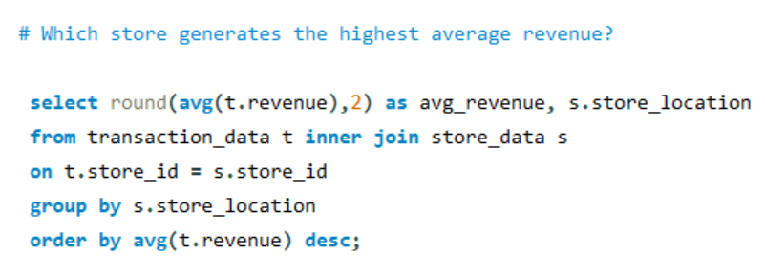
Store-Wise Sales Analysis
Analyzing the average revenue generated by each store in six months.
The results suggest that the Lower Manhattan store has generated the highest average revenue.
Top Ranked Data Science & Analytics Education Provider since 2007

Slide 13
Top Ranked Data Science & Analytics Education Provider since 2007

Slide 14
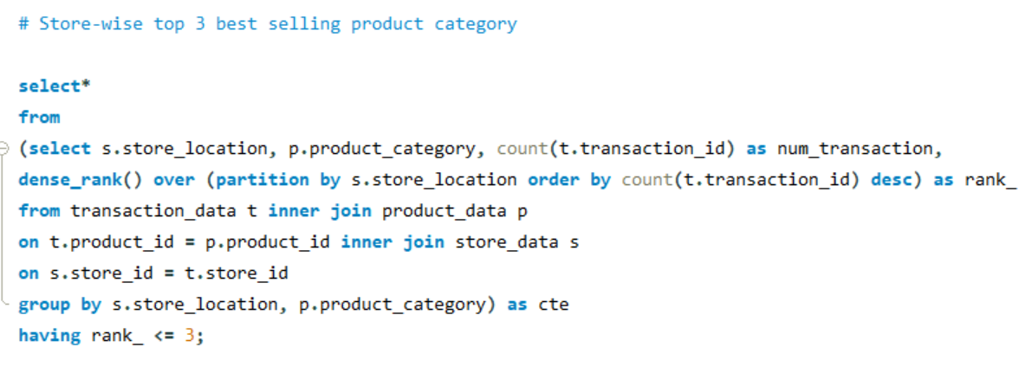
Store-Wise Sales Analysis
Finding out the top 3 best selling product categories in each store.
Top Ranked Data Science & Analytics Education Provider since 2007

Slide 15
Lower Manhattan
Hell’s Kitchen
Product Category | Rank
Coffee | 1
Tea | 2
Bakery | 3
Product Category | Rank
Coffee | 1
Tea | 2
Bakery | 3
Astoria
Product Category | Rank
Coffee | 1
Tea | 2
Bakery | 3
Top Ranked Data Science & Analytics Education Provider since 2007

Slide 16
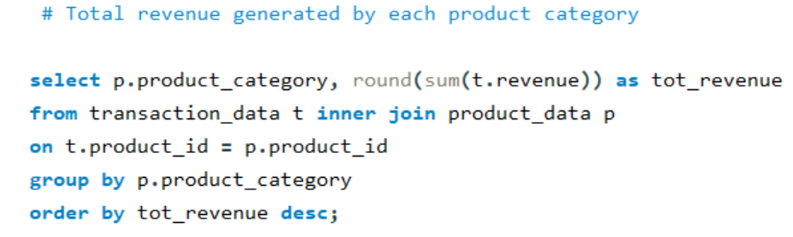
Product Sales Analysis
Analyzing the total revenue generated by each product category.
The results show that Coffee has been the highest revenue generator and Packaged Chocolates have been the lowest revenue generator.
Top Ranked Data Science & Analytics Education Provider since 2007

Slide 17
Top Ranked Data Science & Analytics Education Provider since 2007

Slide 18
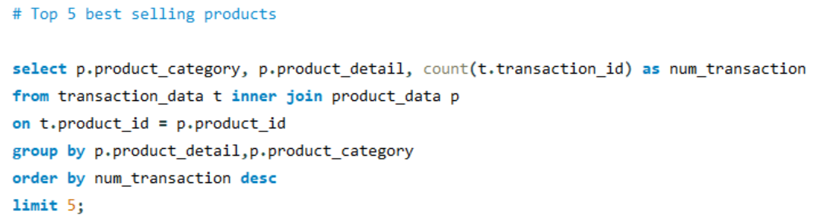
Product Sales Analysis
Finding out the top five best selling products of all times.
Top Ranked Data Science & Analytics Education Provider since 2007

Slide 19
Product Category | Product | Number of Transactions
Bakery | Chocolate Croissant | 3,076
Tea | Earl Grey Rg | 3,053
Drinking Chocolate | Dark chocolate Lg | 3,029
Tea | Morning Sunrise Chai Rg | 3,026
Coffee | Columbian Medium Roast Rg | 3,013
Chocolate Croissant from the product category Bakery is the best selling product of all times.
Top Ranked Data Science & Analytics Education Provider since 2007

Slide 20
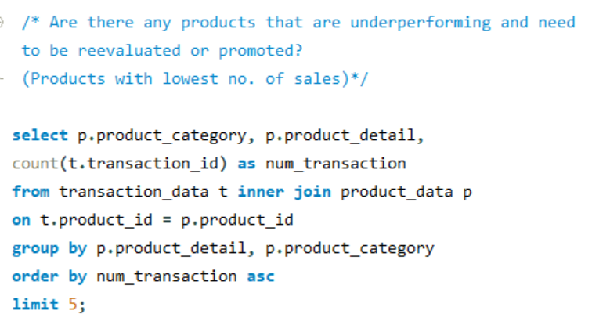
Product Sales Analysis
Finding out the sales-wise lowest 5 products.
Top Ranked Data Science & Analytics Education Provider since 2007

Slide 21
Product Category | Product | Number of Transactions
Packaged Chocolate | Dark chocolate | 118
Loose Tea | Spicy Eye Opener Chai | 122
Coffee Beans | Guatemalan Sustainably Grown | 134
Loose Tea | Earl Grey | 142
Coffee Beans | Jamacian Coffee River | 146
Dark Chocolates have the lowest number of sales .
Top Ranked Data Science & Analytics Education Provider since 2007

Slide 22
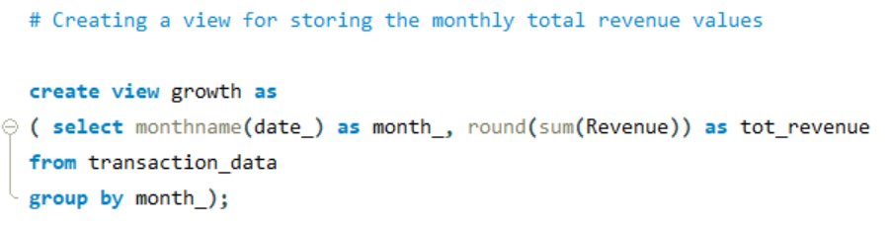
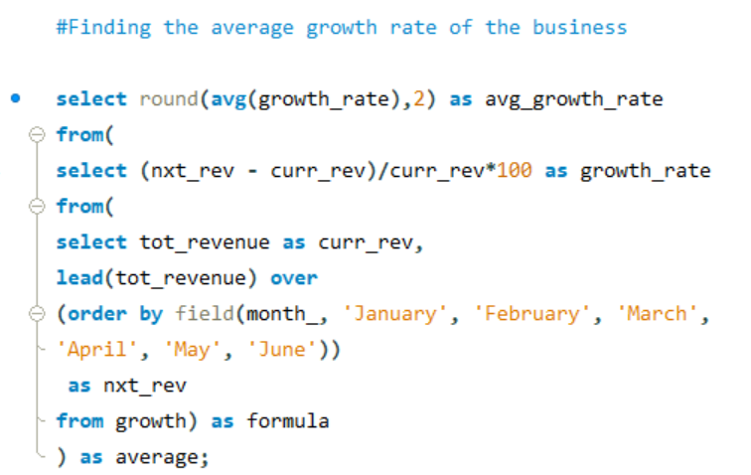
Business Growth Analysis
Analyzing the overall growth of the business from January, 2023 to June, 2023.
Finding out the average growth rate of the business.
According to the results, the average growth rate of the business is 16.27%.
Top Ranked Data Science & Analytics Education Provider since 2007

Slide 23
Top Ranked Data Science & Analytics Education Provider since 2007

Slide 24
Findings
The highest sales occur during the morning hours, particularly between 8:00 AM and 10:00 AM.
Though there is a noticeable decrease in transactions around midday, between 11:00 AM and 1:00 PM, the sales start to increase again in the afternoon. The sales gradually decline again as the evening progresses.
Fridays are the busiest days with the highest number of transactions followed closely by Thursday. Saturday has the lowest number of transactions.
The daily sales trend show that there is no significant variation in sales between different days, suggesting a stable level of sales activity throughout the week.
Lower Manhattan has the highest average revenue per transaction, with an average of $4.81 while Astoria has the lowest average revenue per transaction among the three locations, with an average of $4.59.
Top Ranked Data Science & Analytics Education Provider since 2007

Slide 25
Findings
Coffee is consistently the best-selling product category, ranking first both in terms of the sales volume and total revenue, across all three locations.
Tea follows as the second-best seller and Bakery items as the third in terms of both sales volume and total revenue.
The lowest selling product category are the Packaged Chocolates.
The top five best-selling products are a mix of bakery items, tea, drinking chocolate, and coffee. The Chocolate Croissant leads in terms of the sales volume, indicating its popularity among customers.
Overall, the data suggests that a variety of products contribute to sales, with bakery items, tea, and coffee being particularly popular.
Top Ranked Data Science & Analytics Education Provider since 2007

Slide 26
Findings
From January to June, there is a clear upward trend in total revenue, indicating positive growth for the business.
The months of May and June show particularly strong growth, with revenue nearly doubling from January to June.
The business demonstrates consistent growth over the six-month period and the average growth rate of the business is found to be 16.27%.
Top Ranked Data Science & Analytics Education Provider since 2007

Slide 27
THANK YOU
Top Ranked Data Science & Analytics Education Provider since 2007

